Slide 1

This Week
Analysing Android Applications
Attacking Android Applications

Slide 2
Analysing Android Applications

Slide 3
Creating Your First Android Environment
Understanding Android Applications
Understanding the Security Model
Reverse-Engineering Applications

Slide 4
Introduction
Android is an open source and Linux-based Operating System for mobile devices.
It is developed by the Open Handset Alliance, led by Google.
The first the first commercial Android 1.0 was released in 2008.
Android 4.1 Jelly Bean with the primary aim of improving the user interface was released in 2012.
The source code for Android is available under free and open source software licenses.
Google publishes most of the code under the Apache License and Linux kernel under GNU General Public License.

Slide 5
Introduction …
Features of Android
Intuitive user interface,
Connectivity (e.g. Wi-Fi),
Storage (e.g. SQLite),
Media support (e.g. MPEG-4 SP),
Messaging (e.g. SMS),
Web browser,
Multi-touch,
Multi-tasking,
Resizable widgets, etc.

Slide 6
Introduction …
Android applications are usually developed in the Java language using the Android SDK.
Android stores: Google Play, SlideME, Opera Mobile Store, Mobango, F-droid and the Amazon Appstore.
Android powers hundreds of millions of mobile devices in more than 190 countries around the world.

Slide 7
Introduction …
The Android platform is used by many vendors on phones and tablets.
Due to its open-source nature it can be found on entertainment systems, TVs, e-readers, netbooks, smart watches, car, and gaming consoles.
Android has the biggest market share which attracted the attention of many hackers around the world wanting to expose security flaws.
Vulnerabilities are constantly being discovered in popular applications with varying degrees of severity.

Slide 8
Creating Your First Android Environment
Download the Android Software Development Kit (SDK).
Whether you plan to use an emulator or physical device, the Android SDK provides many tools that are essential for Android hacking.
Android Developer Tools package → integrated development environment (IDE) and all the tools.
Linux is recommended as base OS when testing Android because many of the tools are written for Linux.

Slide 9
Creating Your First …
Shortened listing of Android SDK tools:
Adb- used to interact with devices and emulators to install new applications, gain a shell on the system, read system logs, forward network ports, etc.
Monitor- useful for peeking into running processes on a device and taking screenshots of the device’s screen. It is useful for penetration testers who need to gain evidence of an action for reporting purposes.
aapt- converts assets into binary form to be packaged with applications. It can also perform reverse-engineering tasks that allow to convert binary application resources into readable text.

Slide 10
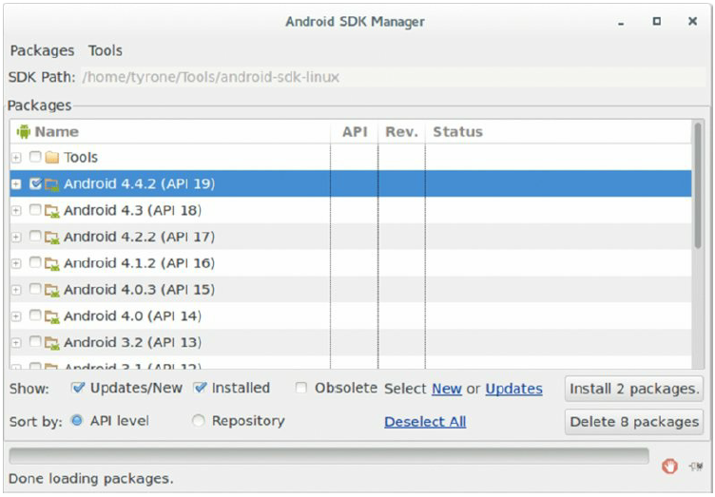
Creating Your First …
Android SDK Manager interface and emulators

Slide 11
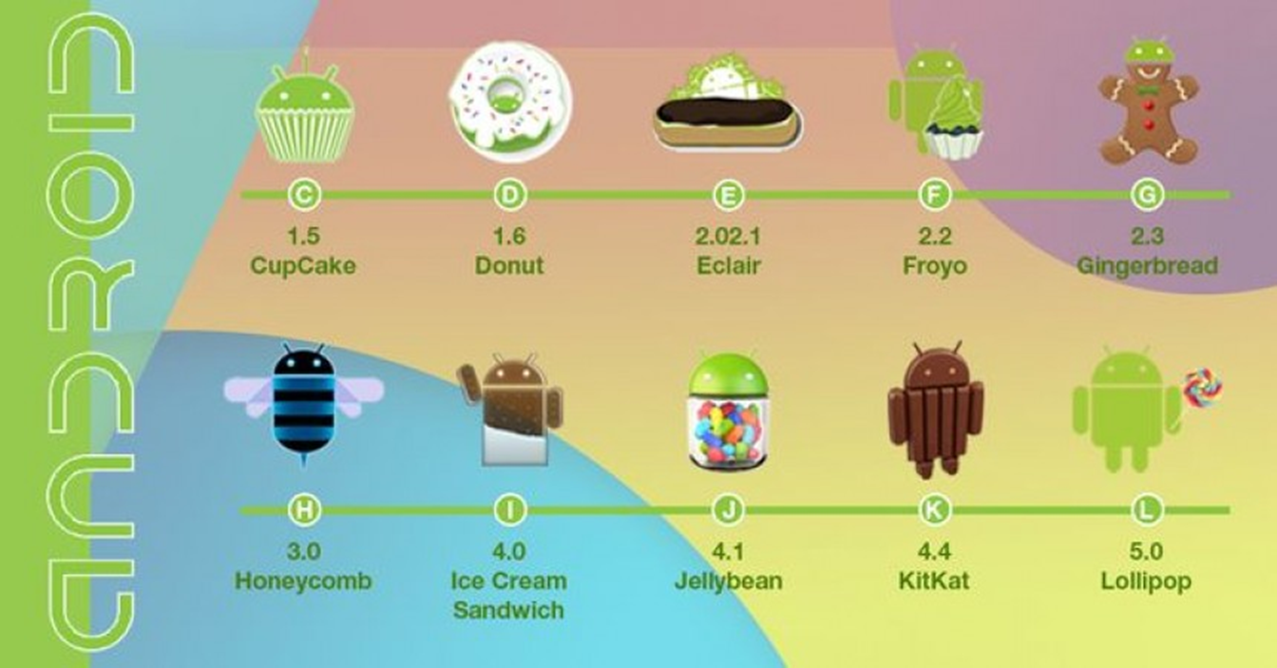
Creating Your First …

Slide 12

Creating Your First …

Slide 13
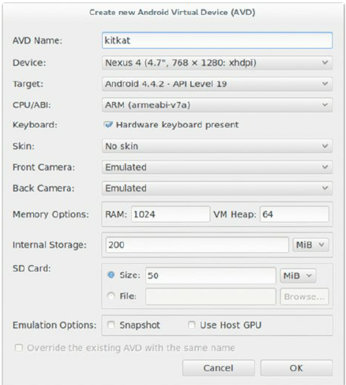
Creating Your First …
AVD Manager’s user interface

Slide 14
Creating Your First …
Actual device and an emulator:
Emulators provide root access by default whereas actual devices do not.
Emulators do not operate correctly for certain applications that make use of physical hardware such as USB, headphones, Wi-Fi, Bluetooth, etc.
You are not able to place or receive real phone calls on emulator but an interface exists to emulate this.

Slide 15
Creating Your First …
Actual device and an emulator:
The Android emulator doesn't include virtual hardware for the following: Bluetooth, NFC, SD card insert/eject, Device-attached headphones, USB, etc.
At the lowest levels of operation, an emulator is not an exact replica of how Android runs on a real device, even though it may feel that way.
You can do a surprising amount of testing or hacking without root access on an Android device.
https://developer.android.com/studio/run/emulator#limitations

Slide 16
Understanding Android Applications
After the application has been installed, a new home screen icon appears that allows one to open the application.
As a technical person, you should not feel satisfied with not knowing exactly how and why installation worked.
What happened behind the scenes when you clicked the button to install that application?
How did this application reach your device?
How did it go from a packaged download to an installed application that you can use securely?
These are all questions that you need to answer before you can be satisfied with moving onto assessing Android applications.

Slide 17
Understanding …
Android OS has two distinct features: modified Linux kernel and an application virtual machine that runs Java-like applications.
The differences between the mainline Linux kernel and the Android kernel have varied over the years.
On conventional Linux, applications that are started by a user are run under that user’s context.

Slide 18
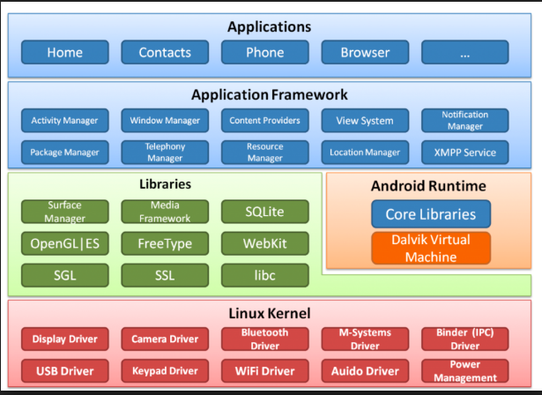
Understanding …
Android Security Framework
18

Slide 19
Understanding …
This model relies on a user’s not installing malicious software on her computer because there are no protection mechanisms against accessing files that are owned by the same user that you are running as.
In contrast to conventional Linux computing, each application that is installed on an Android device is assigned its own unique user identifier (UID) and group identifier (GID).
In certain instances this statement does not hold true and applications can run under the same user - Application Sandbox.

Slide 20
Understanding …
The Dalvik Virtual Machine (DVM) was specifically designed for the Android platform and is unique.
The main reason for its existence is to run on hardware with processing and memory constraints and is much lighter than the normal JVM.
The code that runs on it is written and compiled to Java classes and then converted into a single DEX file using the dx SDK utility.
Android applications are distributed in the form of a zipped archive with the file extension of .apk, which stands for Android Package.

Slide 21
Understanding …
A very strictly defined folder structure is used by every APK as shown below.
/assets
/res
/lib
/META-INF
AndroidManifest.xml
classes.dex
resources.asrc

Slide 22
Understanding …
Assets—Allows the developer to place files in this directory that they would like bundled with the application.
Res—Contains all the application activity layouts, images used, and any other files that the developer would like accessed from code in a structured way. These files are placed in the raw/ subdirectory.
Lib—Contains any native libraries that are bundled with the application. These are split by architecture under this directory and loaded by the application according to the detected CPU architecture; for example, x86, ARM, MIPS.
META-INF—This folder contains the certificate of the application and files that hold an inventory list of all included files in the zip archive and their hashes.
classes.dex—this is the executable file containing the Dalvik bytecode of the application. It is the actual code that will run on the Dalvik Virtual Machine.
AndroidManifest.xml—the manifest file containing all configuration information about the application and defined security parameters.
Resources.asrc—Resources can be compiled into this file instead of being put into the res folder. Also contains any application strings.

Slide 23
Understanding …
APK is installed in Linux using $ adb install /path/to/yourapplication.apk
Installing the APK requires USB Debugging to be turned on in the settings and a physical connection from your device to your computer.
To install an APK by browsing to it on a web server you must first select the Unknown sources box in your device settings.

Slide 24
Understanding …
Using Tools to Explore Android:
ADB is the most useful SDK tool for exploring Android: e.g. show connected devices, push file to .., etc.
BusyBox incorporates a large variety of standard Linux utilities into a single binary.
List all installed $ pm list packages.
Uninstall a package $ pm uninstall <package_name>
drozer is an Android assessment tool that finds vulnerabilities in applications or devices and provides exploits and useful payloads.

Slide 25
Understanding …
Android application components:
Activities - Activities represent visual screens of an application with which users interact. For example, when you launch an application, you see its main activity.
Services - Services are non-graphical components that provide the facility to perform tasks that are long running in the background.
Broadcast receivers - Broadcast receivers are non-graphical components that allow an application to register for certain system or application events.
Content providers - These are the data storehouses of an application that provide a standard way to retrieve, modify, and delete data - SQLite.

Slide 26
Understanding the Security Model
The foundation of the Android application security model is that no two applications running on the same device should be able to access each other’s data without authorization.
They should also not be able to affect the operation of the other application adversely or without the appropriate consent. This concept is the basis of an application sandbox.
An application would need to know whether another application is authorized to perform an action and so the concept of application identity is important.

Slide 27
.. the Security Model
Code Signing - The signing of an Android package is done cryptographically through digital certificates.
The private key is only held by the application developers.
Code signing is used to prove the identity of an application’s author in order to designate a degree of trust to it in other aspects of the security model.
Tools used - $ keytool –genkey, and $ jarsigner … application.apk alias_name

Slide 28
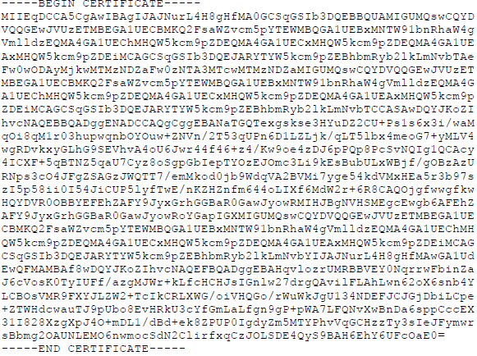
.. the Security Model

Slide 29
.. the Security Model
Application certificates are not verified by the Android operating system in any way and do not need to be issued by a certain Certificate Authority (CA) like other platforms.
The signing certificate is checked only when the application gets installed and if the certificate subsequently expires, the application will still run as normal.
Google recommends that signing certificates be created with a validity period of 25 years or longer to support seamless updates to your application.
A number of vulnerabilities have been discovered in the way that the validation of signatures is performed on APK files.

Slide 30
.. the Security Model
Android employs a fine-grained privilege model for applications to request “permission” to access certain information and resources on a device.
In drozer, permissions that have been requested can be accessed by a command dz> run app.package.info -a com.android.browser.
File system Encryption- Full disk encryption (FDE) is when the contents of a entire drive or volume are encrypted and not only selected individual files.
This serves as protection against stolen or lost disks that have been powered down.

Slide 31
.. the Security Model
FDE has been available on Android since version 3.0 (Honeycomb).
It makes use of the dm-crypt module in the kernel to transparently encrypt and decrypt data on the block device layer.
Rooting - On Android, by default no way exists to run an application or some task within it as the root user.
This has led researchers to finding ways to obtain root on various Android devices.
A typical objective of rooting an Android device is so that you can put a su binary in a directory on the PATH (forexample, /system/bin or /system/xbin).

Slide 32
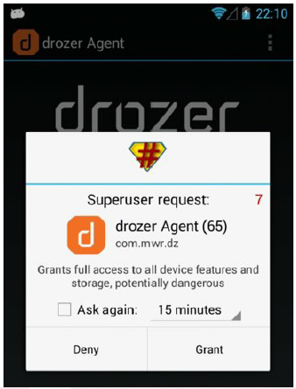
.. the Security Model
An example of a prompt from the SuperSU application

Slide 33
Reverse-Engineering Applications
Reverse-engineering is the process of gaining a deep understanding of a finished product.
In Android, first, find the package of a target application using $ adb shell pm list packages | grep app-name
To pull the app off the device you need to find the APK path is stored using $ adb shell pm path package-name
To reverse engineer applications from the Play Store, you would need to install them onto a device you or get direct APK download by sending package name to sites like http://apps.evozi.com/apk-downloader/.
Use the Android Asset Packaging Tool (aapt) that comes with the Android SDK to get the manifest file as next: $ aapt dump xmltree /path/to/agent.apk AndroidManifest.xml

Slide 34
Reverse-Engineering …

Slide 35
Reverse-Engineering …
Dalvik bytecode contained within DEX files can be disassembled into low-level human-readable assembly using $ ./dexdump -d /path/to/classes.dex
Apktool is used to reverse-engineer an entire Android package back for modification.
Other disassemblers are Baksmali and IDA.
IDA is a very popular disassembler used by reverse engineers all around the world.

Slide 36
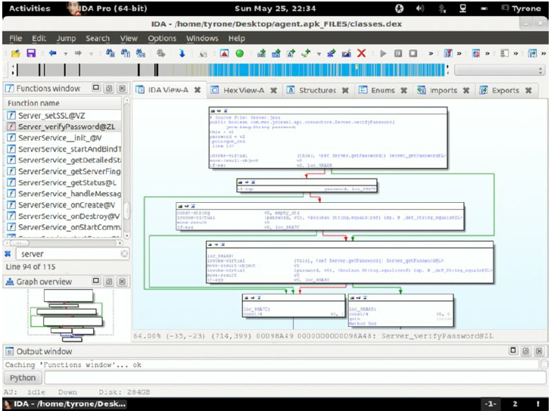
Reverse-Engineering …

Slide 37
Attacking Android Applications

Slide 38
Exposing Security Model Quirks
Attacking Application Components
Accessing Storage and Logging
Misusing Insecure Communications

Slide 39
Exposing Security Model Quirks
Three high-level components to consider for each application are application container, communications, and Internet server.
Exported components (APIs) of an application can be found and exported by inspecting the its manifest. An example in drozer is below:
dz> run app.package.attacksurface com.android.browser
Attack Surface:
6 activities exported
4 broadcast receivers exported
1 content providers exported
0 services exported
The root and system users can exert control over installed applications.
The root and system users can interact with application components even when they are not exported.
Whether an application exports a component in its manifest or not is relevant only when the calling application is another non-system application.

Slide 40
Exposing Security …
Mark Murphy described a scenario where the signature protection level could be bypassed.
The first application to define a permission also sets the permission’s attributes regardless of applications that may define the same permission after that.

Slide 41
Exposing Security …
The following is the attack scenario:
1. An installed malicious application defines a set of known permission names from popular applications with a protection level of normal.
2. The user then installs a popular application and the OS sees that one of the permissions is already defined. This leads the OS to ignore the protection level of the permission and stick to the known parameters already defined by the malicious application.
3. The permission that is supposed to be used to protect application components now has a downgraded protection level of normal instead of another more secure value like signature. Even though the permission was defined with a signature protection level, which was defined by the legitimate application, Android does not know any different.
4. The malicious application can interact with the no-longer protected application components defined with the downgraded permission.
As a proof of concept, we perform a practical example of this attack on the Twitter application here. The Twitter application defines a number of permissions, which are bolded: dz> run app.package.info -a com.twitter.android

Slide 42
Attacking Application Components
Attacking another application over the Android IPC system involves finding all the exported components of the application.
Also it involves attempting to use the components in a way that was not intended.
For activities, broadcast receivers, and services this means you must examine all the code that handles intents from other applications.
In Android, an intent is a data object that loosely defines a task to be performed.
Intents can be matched against intent filters using three types of information- Action, Data, and Category.

Slide 43
Attacking Application …
Sieve, a ‘Password Manager’ App, showcasing some common Android vulnerabilities is mentioned in the book.
A user who has configured Sieve is presented with a password prompt when logging in after device power up and then a PIN prompt thereafter.
After installing it, you can find the package name of Sieve by using the app .package.info module with a filter for the word Sieve, which is the icon label.
Get package using drozer dz> run app.package.list -f Sieve
Examine exported application components of Sieve in its manifest using one of several tools (e.g. drozer).

Slide 44
Accessing Storage and Logging
The “sandbox” provided for the segregation of application data is largely based on file and folder ownership and permissions.
Each file and folder belongs to an owner and a group.
The owner and group of a file can be changed using a tool named chown as the root user.
You can set permissions using a tool named chmod.
Job done!

Slide 45
Misusing Insecure Communications
The power and functionality of most applications come from sending and receiving information from services on the Internet.
Installed applications provide users with rich native user interfaces that outperform the use of web browsers on devices.
Applications are often designed to make use of HTTP/HTTPS in order to easily integrate into existing infrastructure.
However, such implementation is often less secure than web browsers which may also make use of other communication protocols.
Thus, the flaws in communication mechanisms of the app can be misused to attack the device.

Slide 46
Exercises & next time
Now it's time for group work/Lab!
In this room (A5-10) until 4PM.
Today's exercises:
Analysing Android Applications
Attacking Android Applications
Main topics, next time:
Identifying and Exploiting Android Implementation Issues Writing Secure Android Applications

